Slide 1
Introduction to Linux
Prof. Joonwon Lee(joonwon@skku.edu)
TA – Sungin Hong(sungin.h@skku.edu)
Sewan Ha(hsewan2495@gmail.com)
Computer Systems Laboratory
Sungkyunkwan University
http://csl.skku.edu

Slide 2
Announcement (1)
You need to install Linux
You can install “VirtualBox”
last slide is uploaded at i-campus.
Or you can use this room
If you want to use this room, you should install Linux on VirtualBox again.
We will save current PC state if you do so(please say to TA and do not shut down after finishing lab exercise)
You should use the same computer during this semester
Don’t forget the root’s password which you set during installation period
We recommend using your laptop or own external storage

Slide 3
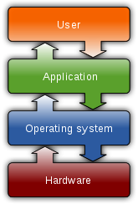
What is OS? (1)
Operating System(OS)
Manages computer hardware and software for the user
Perform repetitive hardware tasks : managing files, running programs, etc
Manages software applications : controls the loading and execution of all programs
하드웨어랑 소프틔웨어를 관리하는역할

Slide 4
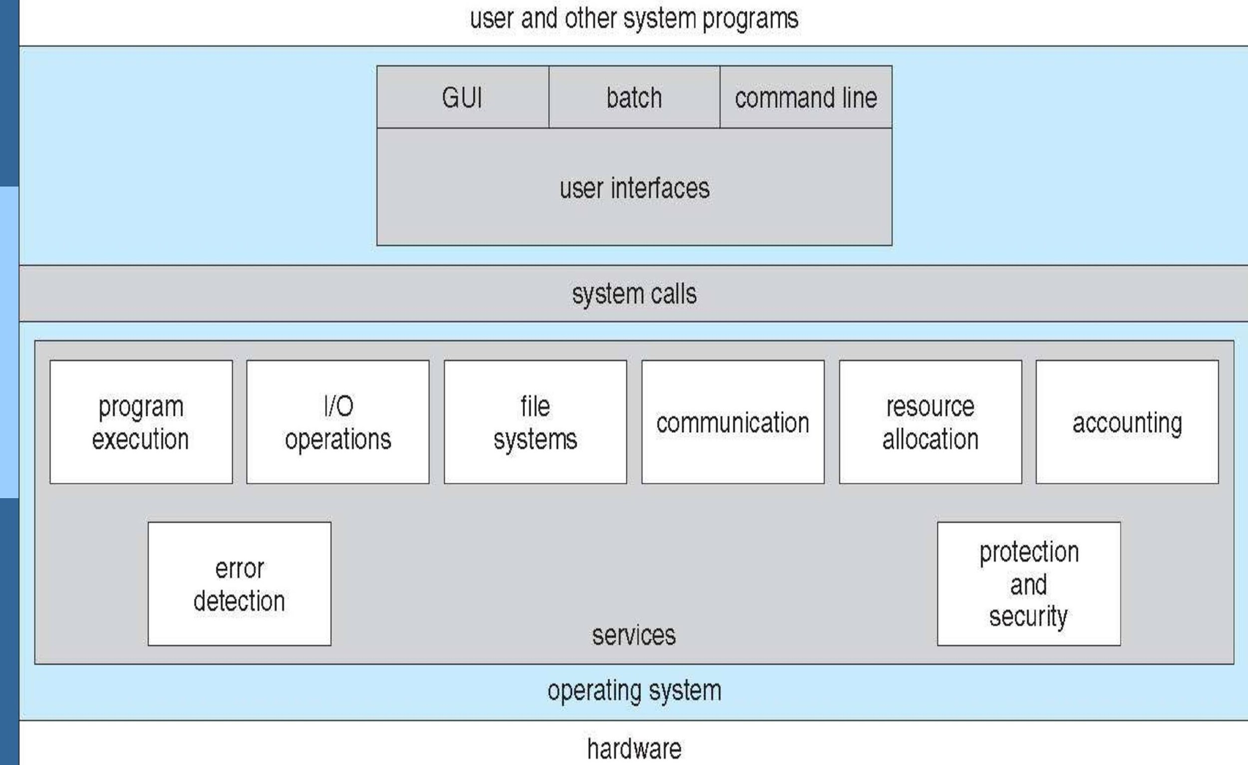
What is OS? (2)
View of Operating System Services

Slide 5
What is OS? (3)
Application side
Provides the program execution environment
Hides the messy details which must be performed
Make machine easy to use
Provides an abstract view of the underlying system
Processors -> Processes, Threads
Memory -> Virtual memory
I/O devices -> Files

Slide 6
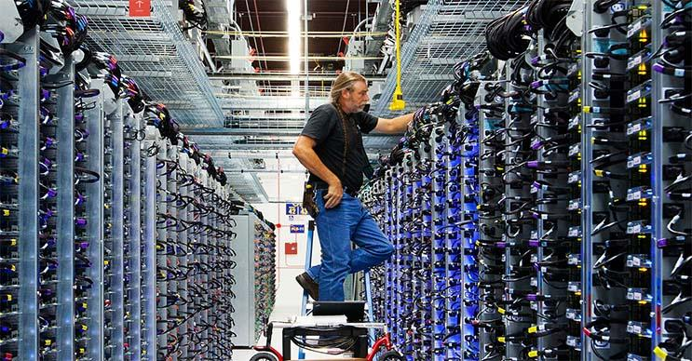
What is OS? (4)
System side
OS is a resource manager
Sharing
Protection
Fairness
Performance
What is resource?
Hardware
CPU, Memory, I/O devices
Software
Queues, …
Miscellaneous
Energy, Power, …

Slide 7



What is OS? (5)
Types of OS

Slide 8
Unix (1)
History and motivation
Originally developed by Ken Thompson, Dennis Ritchie and researchers at AT&T Bell Labs for internal use in the early 1970s
Borrowed best ideas from other OS’s
“OS for researchers” : to meet researchers’ changing demands, flexibility > hardware efficiency
Unix is designed so that users can extend the functionality – to build new tools easily and efficiently
Why Unix?
Used in many scientific and industrial settings
Huge number of free and well-written software programs
Many important OS concepts are developed on Unix.

Slide 9
Unix (2)
Unix is
Interactive
Time-sharing
Multi-tasking
Multi-user
Flavors of Unix
System V (AT&T->USL->Novell->SCO->Caldera->SCO)
BSD (UC Berkeley)
SunOS, Solaris (Sun)
IRIX (SGI), AIX (IBM), HP-UX (HP), Mac OS X (Apple)
Linux, FreeBSD, NetBSD, and etc..

Slide 10
Linux
Open-source development began in 1991
First released by Linus Torvalds
Linux can be generally divided into three major components: kernel, environment, file structure
Linux kernel
The core of Linux system
Runs programs and manages hardware
Thousands of contributors
Supervised by Linus and other maintainers

Slide 11
Linux
Environment
Provides an interface for the user
File structure
Organizes the way files are stored
Linux distribution
Operating system based upon the Linux kernel
A collection of software based around Linux kernel
Red Hat, Fedora, Debian, Ubuntu, Android, …

Slide 12
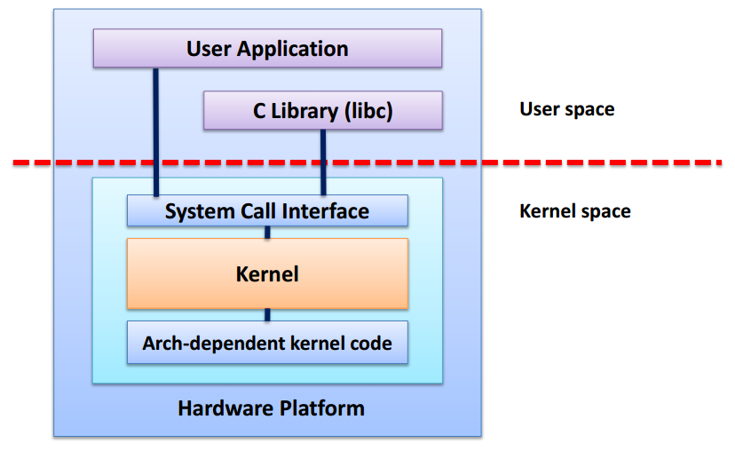
OS Internals (1)

Slide 13
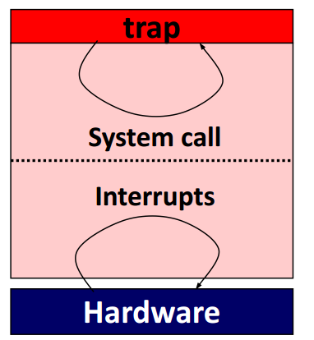
OS Internals (2)
A software between applications and hardware
Highly-concurrent
Event-driven
What kind of events?
System calls
Interrupts

Slide 14
User Interfaces
The space where we interact with machines
Command-line interface (CLI) : ctrl + alt + F1
Command interpreter
Difficult to learn
In Ubuntu, ctrl+alt+F2~6 to access CLI mode
Graphical user interface (GUI) : ctrl + alt + F7
KDE, Gnome, Unity, Xfce, …
In Ubuntu, ctrl+alt+F1 to access GUI mode
Touch user interface
Smartphones, tablets

Slide 15
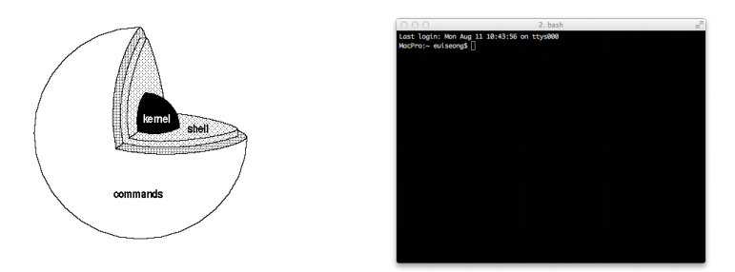
Shell (1)
A system program that allows a user to execute
Interpretive environment within which you execute
Shells execute commands by means of processes
An instance of a program in execution

Slide 16
Shell (2)
Various Shell exists
Bourne shell(sh)
C shell(csh)
Bourne again shell(bash): default
TENEX C shell(tcsh)
Korn shell(ksh)
There are two families of shells
One based on “Bourne shell” (sh)
We will use “Bourne again shell” (bash) for the course
The other based on “C shell” (csh)

Slide 17
Shell (3)
Executing programs on a shell
$ command [options] [arguments]
[$ ls] and [$ ls –al] show different results
All commands, options, arguments are case-sensitive
A shell allows three types of commands
An internal shell command (built-in command)
An executable file that contains object code
An executable file that contains a sequence of shell command lines (shell script)

Slide 18
File System Overview (1)
“Everything is a file” in Unix
Documents, directories, hard-drives, network sockets, keyboards, printers are stream of bytes exposed through the file system namespace
Organize and exchange data more easily
A Unix file is a sequence of bytes(byte stream)
Collection of related information defined by its creator
Unstructured sequence of bytes
Allows Unix to apply the file concept to every data component in the system

Slide 19
File System Overview (2)
File system
Consist of two distinct parts:
collection of files + directory structure
It provides the mechanism for on-line storage and access to file contents
Features of Unix file system
A hierarchical structure
It allows dynamic growth of files
The ability to create and delete files
The protection of the file data
Unix treats the peripheral devices as files

Slide 20
File System Overview (3)
Hierarchical, tree-like structure
Root
Non-leaf nodes
Directories
Leaf nodes
Directories
Regular files or special device files

Slide 21
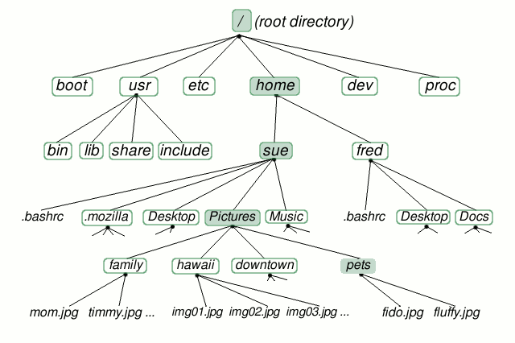
File System Overview (4)
*http://www.linuxplanet.com/linuxplanet/tutorials/6666/1

Slide 22
File System Overview (5)
Root directory ["/"]
The top-most directory in a hierarchy
Home directory ["~"]
A special directory for a user
It contain the user’s files; including texts, musics, videos, or configuration files
(Current) Working directory [“.”]
Each process has associated with it a directory
The directory where a user currently located
Parent directory [“..”]
The directory which holds current directory

Slide 23
File System Overview (6)
/bin
Contains certain standard commands + fundamental utilities
/usr/bin
Holds user-oriented commands + utility programs
/dev
Essential devices
/etc
Host-specific system-wide configuration files(system files)
/tmp
A place for temporary files
/var
A place for files that may change often

Slide 24
Path
The general form of the name of a file or a directory
Delimiting characters ["/"]
Represent each directory in path expressed in string
Absolute path (full path)
A path points a location regardless of present working directory
Beginning with the root directory
$ cat /home/sanghoon/textfile
$ cat ~/textfile
Relative path
A path relative to the working directory of the user
$ cat textfile [if cwd is "/home/sanghoon"]

Slide 25
File Permission(1)
File permission indicates who can access the file
Every files have a set of permissions
You can check file permission using command ls –l (ll)
Ownership
User/owner : The person who owns/created the file.
Group : Unix allows for the creation of groups
Others : Everyone else in the world that has access to that computer
Permission for Access
Read (4)
Write (2)
eXecute (1)

Slide 26

File Permission(2)
Symbolic notation
Format:Filetype(1)Owner(3)Group(3)Others(3)
Filetype
- : general file
d: directory
Permission
r: reading is permitted
w: writing is permitted
x: execution is permitted
-: not permitted
s: setuid(4000) or setgid(2000) (S: not executable)
t(1000): sticky bit (T: not executable)

Slide 27
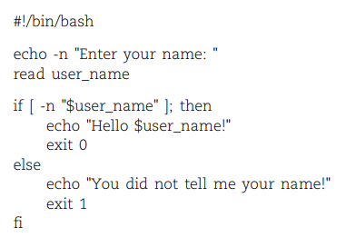
Shell Scripts(1)
A file that contains shell command
Combines Linux commands in such a way as to perform a specific task
Example of shell command

Slide 28
Shell Scripts(2)
Shell variable
Variable within shell
Have the same naming rule as C
= : assignment
e.g) os = linux : os variable assigned the string “linux”
$ : value
e.g) echo $os : terminal shows “linux”(value of os)
echo os : terminal shows “os”
Quotation
“” : quoting as strings(except $)
‘’ : quoting as commands – assign the written command to a variable
Use variable name as another name for the linux command
``(Back quotes): value from Linux commands – executed -> arguments

Slide 29
Shell Scripts(3)
Script Arguments
Arguments on the command line are referenced sequentially starting with 1
e.g) $1 stands for first argument
Executing script
chmod +x [filename] : to add execution permission on shell script file
[filename] or ./[filename] : to execute script

Slide 30
Basic File I/O
Opening a file
int fd = open(“path”, flags)
Read a character from a file
read(fd, &c, 1)
Write a character to a file
write(fd, &c, 1)
Closing a file
close(fd)

Slide 31
Exercise

Slide 32
Contents
Basic commands
Basic C coding
Basic File I/O

Slide 33
Basic commands (1)
man
Display the manual page
Display a manual of a program or a function
You can use “info” or “help” as alternatives
$ man qsort
$ man man (manual for manual page)

Slide 34
Basic commands (2)
ls
List files
$ ls
$ ls -al /etc
$ ll(same as ls –l)
ps
List process
$ ps
$ ps –ef
$ man ps

Slide 35
Basic commands (3)
pwd
Print working directory
cd
Change working directory
$ cd ..
$ cd /proc
$ cd ~

Slide 36
Basic commands (4)
echo
Display a line of text
$ echo "Hello?"
printf
Print a formatted line of text
$ printf "%s\n" Hello?

Slide 37
Basic commands (5)
cat
Displaying files
$ cat /etc/issue
more / less
Displaying files + move forward or backward possible
Less is more powerful and configurable display utility

Slide 38
Basic commands (6)
mkdir / rmdir
Make / remove a directory
$ mkdir swex1
mv
Move or rename files
$ mv swex1/ swex2/
cp
Copy files
$ cp –r : copies a subdirectory from one directory to another
rm
Remove files
$ rm –r : delete all subdirectories and files

Slide 39
Basic commands (7)
date
Print or set the system date and time
grep
Searching files for a specified expression
$ grep [expression] [files]
$ grep root /etc/passwd

Slide 40
Basic commands (8)
chmod
Change the permissions on a file or directory
$ chmod u=rw file1
$ chmod u+x,g+w,o-r file2
$ ls –l swex2/
$ chmod 750 swex2/
$ ls –l swex2/
u user + to add a permission r(4) read
g group - to remove a permission w(2) write
o other = to assign a permission explicitly x(1) execute (for files),
access (for directories)

Slide 41
Basic commands (9)
diff [file1] [file2]
Reports line-by-line differences between file1 and file2
history
Shows the history of the typed command
You can reuse your previous commands using arrow keys(up/down) until commands are deleted in history
$ history

Slide 42
Basic commands (10)
Special characters
| : Pipeline
Output of a process feeds directly as input to next one
$ ls –help | less
> >> < &> : Redirection
Redirect standard output/error to a file or a file stream to standard input
$ echo “hello” > hellofile

Slide 43
Development tools
vi[m]
A text editor for programmers
$ vim [file_name]
(if not exist) or open a file 'file_name‘
http://csl.skku.edu/SSE2033S17/Resources
$ vim hello.c
gcc
GNU compiler collection
$ gcc –o hello hello.c
$ ./hello

Slide 44
hello.c
#include <stdio.h>
int main(void)
{
printf("hello, world\n");
return 0;
}

Slide 45
Exercise (1)
Lab exercise #1:
Make "sse" directory on your home directory
Create hello.c on the directory
Compile it
Run the program
Remove "sse" directory
Lab exercise #2:
With hello.c file, make shell script that run exercise #1 automatically.

Slide 46
Exercise (2)
Lab exercise #3:
Create “exercise” directory
Allow to read, write, and execute to only owner
Write a manual for ps command
e.g) psmanual
Write a “count.c”
counts the number of alphabets(case-insensitive) in psmanual
Prints the number on standard output
Compile and execute

